Slide 1

Introduction to Public Health
PUBH01101
Environmental Health & Safety
Session 9
Logan University
College of Health Sciences
David Beavers, MEd, DC, MPH, FIACA

Slide 2
NOTE
PowerPoints and assigned readings are designed to complement each other and the assigned textbook readings

Slide 3
Learning Objectives
Define the scope of morbidity and mortality caused by the physical environment
Identify the range of interactions that occur between human beings and the physical environment
Identify the components of environmental risk assessment and apply them to an environmental hazard, such as lead

Slide 4
Learning Objectives
Distinguish between a risk assessment, a public health assessment and an ecological assessment
Discuss the meaning of interactions and how they may impact the size of risks
Describe how intentional and unintentional injuries can be addressed to prevent their occurrence and diminish their consequences
Identify successes of outbreak investigations

Slide 5
Vignette 1
Joe grew up in an industrial district of town. His family lived in an old apartment building, and he played in a playground near a major intersection.
By the age of 6, Joe was found to have high lead levels in his blood and was not doing well in school.
“Where could all that lead come from?” his mother wondered.

Slide 6
Vignette 2
Jill is pregnant and loves fish, which she has eaten almost daily for years as part of her effort to stay healthy.
She hears that fish should not be eaten regularly during pregnancy.
Why, she wonders, should I cut down on eating something as healthy as fish?

Slide 7
Vignette 3
Ralph and Sonya, a prosperous professional couple, and their two children live in an older suburban home. They feel secure that their environment is safe.
They were surprised to find when they wanted to put their house up for sale that it did not pass the safety tests for radon.
Where did the radon come from, they wondered, and what can be done about it?

Slide 8
Vignette 4
Sandra worked for an international agency that had successfully addressed the danger of radiation due to the hole in the ozone layer.
She was shocked when she was told that she had a life-threatening skin cancer called melanoma.
She asked: What could cause melanoma and could years of sun exposure have played a role?

Slide 9
Vignette 5
You set out on your commute to work, and as you approach the subway station, you see police cars, ambulances, and dozens of emergency responders in hazmat suits. You are told the entire subway system will be shut down indefinitely, as there has been a suspected case of bioterrorism.
You wonder how authorities were alerted to this situation and what precautions are being taken to protect the health of those living in the city?

Slide 10
Vignette 6
Alex suffered a traumatic brain injury when he was thrown from his motorcycle after colliding with a car in which the driver had an elevated blood alcohol concentration. Alex was not wearing a helmet.
His family members wonder what is being done to prevent this from happening to others?

Slide 11
Concepts to consider 1
What is meant by “environment”?
What is the burden of disease due to the physical environment?
How do we interact with our physical environment?
How does risk assessment address the impacts of the physical environment?

Slide 12
Concepts to consider 2
What is a public health assessment?
What is an ecological risk assessment?
What is an interaction analysis approach to environmental diseases?
What do we mean by intentional and unintentional injuries?
What is being done to keep the population safe?

Slide 13
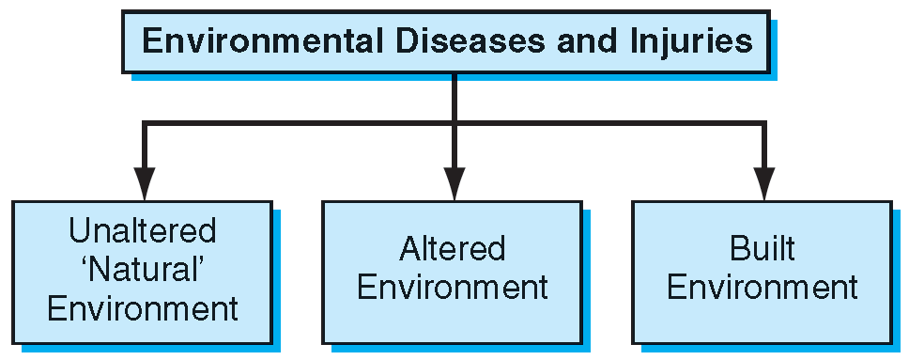
Three parts of the Scope of Environmental Diseases and Injuries

Slide 14
What is Meant by “Environment”?
The physical environment can be thought of in three categories:
  Unaltered environment - ‘Natural’
  Altered environment - the result of added chemicals, radiation and biological products
  Built environment - result of human construction
    Injuries and exposures in the home, the transportation system and where we work and play

Slide 15
Video about NIEHS
National Institute of Environmental Health Sciences (NIEHS)
Watch video at: https://www.youtube.com/watch?v=Hce5sSF7Ht8

Slide 16
What is the Burden of Disease Due to the Physical Environment?
Measuring the impact of the physical environment is difficult because there are many types of impacts and effects are often subtle
The altered environment impacts the entire ecosystem
  Long term and mostly irreversible consequences
A broad and long-term perspective is needed when addressing environmental health

Slide 17
Environmental Health Topics 1
Conditions & Diseases: evidence shows may be strongly linked to environmental exposures
  Asthma
  Autism
  Breast Cancer
  Cancer
  Lung Disease
  Lupus
  Obesity
  Parkinson's Disease
  Reproductive Health

Slide 18
Environmental Health Topics 2
Chemicals and other factors that may cause adverse health effects
  Air Pollution (next slide)
  Allergens & Irritants
  Arsenic
  Bisphenol A (BPA)
  Cell Phones
  Dioxins
  Electric & Magnetic Fields
  Endocrine Disruptors
  Formaldehyde
  Hazardous Material/Waste
  Lead
  Mercury
  Mold
  Nanomaterials
  Ozone
  Pesticides
  Radon
  Soy Infant Formula
  Styrene (plastics/resins)
  Water Pollution

Slide 19
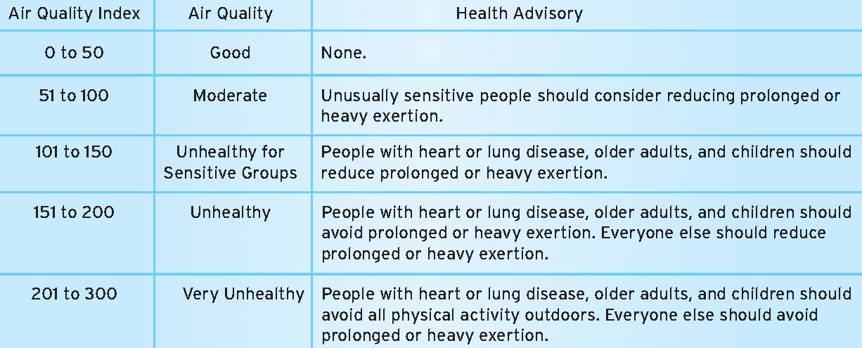
Air Quality Index for Particle Pollution

Slide 20
How Do We Interact with Our
Physical Environment?
We are exposed to the physical environment every minute of our lives through multiple routes:
  Skin
  Respiratory tract
  Alimentary or digestive tract
  Genital-urinary tract

Slide 21
How Does Risk Assessment Address the Impacts of the Physical Environment?
Risk assessment is a formal process that aims to measure the potential impact of known hazards
A hazard indicates the inherent danger of an exposure
Risk assessment aims to take into account the inherent danger of the exposure as well as:
  Route
  Timing
  Quantity

Slide 22
How Does Risk Assessment Address the Impacts of the Physical Environment?
Risk assessment attempts to evaluate the impact of environmental exposures one at a time
  Measures the types and magnitudes of the impacts
If a substantial risk is found to exist, the process then reviews options to protect, detect, and react to the risk to minimize the burden of disease on humans

Slide 23
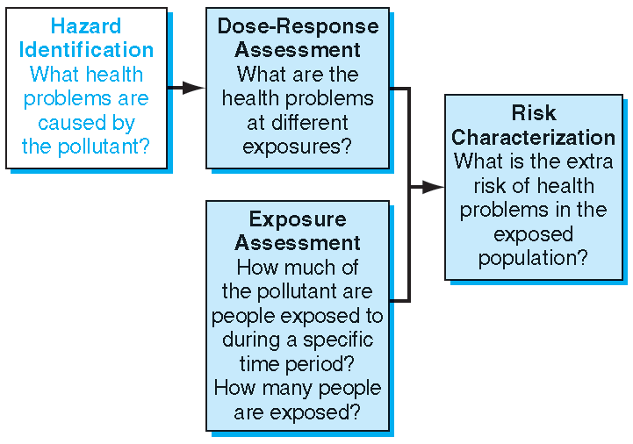
Four-Step Risk Assessment Process

Slide 24
Four-Step Risk Assessment and Simplified Example: Benzene
Components | Simplified example—benzene
Hazard identification | Benzene causes leukemia Strong evidence from cohort studies and supportive animal data exist
Dose-response relationship | Strong dose-response relationship among occupational workers with level of 1 ppm over a working lifetime The impact of exposure at 1 ppm is indistinguishable from unexposed, with rapid increase in rates of leukemia above that level
Exposure assessment | Industrial exposures above 1 ppm are common in a range of industries at the time the standard was set Over 250,000 workers exposed to benzene
Risk characterization | 14–17 excess cases of leukemia per 1,000 workers exposed to 10 ppm throughout a working lifetime

Slide 25
Public Health Assessment
A public health assessment goes beyond a risk assessment by including data on actual exposure in a community
Addresses not just the risks in a specific location, but also the risks to large numbers of individuals and often to the population as a whole
Often they are very controversial
  Can take years, or even decades, to complete

Slide 26
Where Does Lead in our Bodies Come From and What Can Be Done About It?
How lead enters our bodies | Where it comes from | Ways to reduce exposure
Inhalation | Workers in many lead-exposure industries Demolition and renovation activities that generate fumes and dust Addition of lead to gasoline Once inhaled deep into the lungs, it may remain for long periods and be absorbed into blood over time | Occupational controls Phase out of lead in gasoline in US from 1976 to 1996
Ingestion | Children—normal ingestion of dirt and dust by infants and young children, with up to 5% of children who ingest large quantities—a condition called “pica” Children absorb greater percentage of ingested lead than adults | Removal of lead paint from older homes—lead levels in paint in the 1950s and earlier were as much as 50% lead Enforce elimination of lead paint from children’s toys

Slide 27
Where Does Lead in our Bodies Come From and What Can Be Done About It?
How lead enters our bodies | Where it comes from | Ways to reduce exposure
Ingestion | Children’s toys and objects Soil near high traffic areas often contaminated from lead in gasoline Glazed pottery often includes lead that can leach into food | Monitoring and control of lead levels in soil in young children’s play areas Very high blood levels may require “chelation”
Water | Pipes, especially in older water supplies and homes, often contain lead Lead used in pipes outside and within the home can leach into water | Regulation of levels of lead in public water supply Run home water before use Use cold water for cooking
In utero | Pregnant women absorb higher percentage of ingested lead; can cross placenta Mother’s previous lead exposure stored in bones can be resorbed into blood | Special effort to reduce exposure by pregnant women, including special care with home renovations during pregnancy, especially homes built before 1970

Slide 28
What is an Ecological Risk Assessment?
Ecological risk assessment examines the impacts of contaminants on ecological systems ranging from chemicals, to radiation, to genetically altered crops
Examines not only human health effects of exposure, but also includes the impact of contamination or pollution on plants and animals and the ecosystems in which they exist
  Many long term consequences to be examined

Slide 29
What is an Interaction Analysis Approach to Environmental Diseases?
Interaction analysis implies that to understand and control the impacts of environmental exposures, it is necessary to take into account the effect of two or more exposures
Adding together the relative risks of two exposures may provide a good approximation of their effects
  However, there are often interactions between exposures that lead to an impact much greater than this estimate (multiplicative interaction)

Slide 30
What Do We Mean by Intentional and Unintentional Injuries?
Intentional injuries
  Brought on by purpose, whether the injury is
  self-inflicted or meant for others
    Bioterrorism, suicide
Unintentional injuries
  Occur not on purpose
    Motor vehicle collision, drowning, fall, fire

Slide 31
What is Being Done to Keep the Population Safe?
All-hazards approach
  Using surveillance systems, communication systems, evacuations, and an organized health care response
Outbreak investigations
National Incident Management System (NIMS)
  Incident Command System (ICS)
CDC Injury Center
  Explore this web site
  https://www.cdc.gov/injury/

Slide 32
end
If you have any questions, contact me via Canvas e-mail

